Slide 1
Dynamic Programming

Slide 2
Coin Change
Why and how to reduce the space requirement?

Slide 3
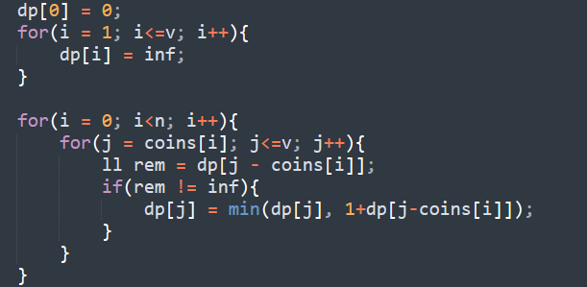
Coin Change 1

Slide 4
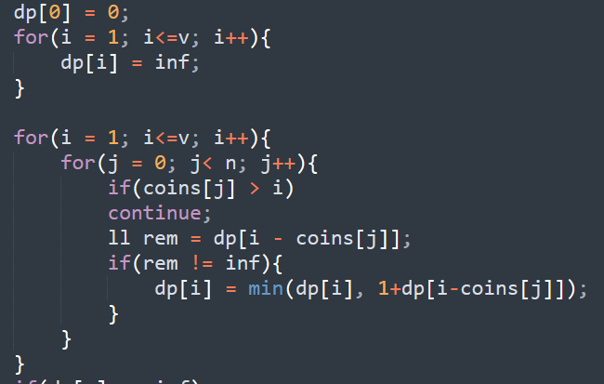
Coin Change 1

Slide 5
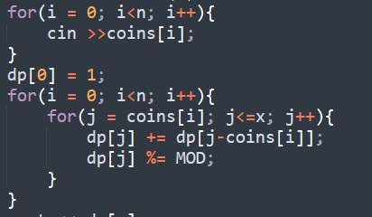
Coin Change 2

Slide 6
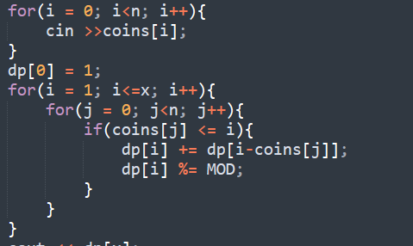
Coin Change 3

Slide 7
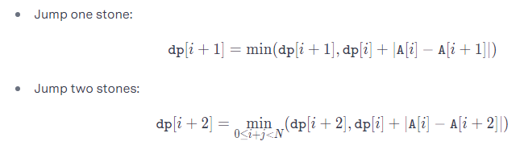
Frog 1

